Slide 1


Titolo presentazione sottotitolo
EMBEDDED SYSTEMS PROJECT
Milano, XX mese 20XX
Maitan, Medvedec, Megler, Paone

Slide 2
OUTLINE
INTRODUCTION
HARDWARE
GPIO
TIMER
INTERRUPT
SOFTWARE
DECODING
ENCRYPTING
ENCODING
TESTBENCH

Slide 3
INTRODUCTION
The project addresses the problem of a plaintext excryption using microcontroller based application.
The application is performing the following tasks:
Acquire plaintext input
Generate ciphertext using the Caesar cipher
Display outcome of the encryption using the output

Slide 4
INTRODUCTION
The project addresses the problem of a plaintext excryption using microcontroller based application.
The application is performing the following tasks:
Acquire plaintext input ➔ HARDWARE
Provide the Morse message using pushbuttons on the board
Generate ciphertext using the Caesar cipher ➔ SOFTWARE
Display outcome of the encryption using the output ➔ HARDWARE
Output the ciphertext Morse code using LEDs

Slide 5
HARDWARE
GPIO:
Both GPIOs located on the board are used
GPIO_0 ➔ communicates with LEDs
GPIO_1 ➔ bound to the pushbuttons
TIMER:
Systick timer is used to measure the time when a button press occurs in order to understand if the signal is long or short

Slide 6
HARDWARE
INTERRUPT:
Generates a signal event that stops the normal execution of the instruction flow
Each GPIO has its own handler in order to react to the events
GPIO_1 handler manages button presses
Systick handler is called when the timer expires

Slide 7
SOFTWARE
The software that takes care of receiving the input characters and handling them through a “pipeline” is composed of three main steps:
Decoding ➔ using Morse signals to build a word in a form of a string formed by ASCII characters
Encrypting ➔ takes the word and encrypts it with Caesar cipher
Encoding ➔ generates a set of Morse signals starting form the encrypted ASCII string

Slide 8
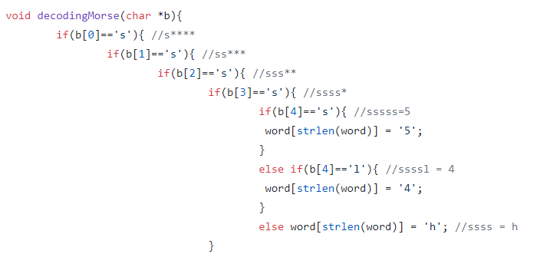
DECODING
The microcontroller receives, through the GPIO, a word encoded in Morse code. In order to be able to manage the characters and encrypt them, we need to convert them in ASCII!
The following function decodes a single character

Slide 9
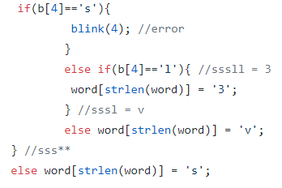
DECODING
Despite the length of the function, the rationale is quite simple
Pass the sequence of ‘s’ and ‘l’ characters to the function
Get to a «leaf» node corresponding to the ASCII character (or to an error)
Append the recognized character to a global variable called word

Slide 10
ENCRYPTION
Once we have all the ASCII characters corresponding to the input word, we can use a Caesar’s cipher with key = 3 to encrypt it.
This requires
Defining an «alphabet» (in our case it has length 36)
Retrieve the «position» i of a character in the alphabet
With function strchr(alphabet, character)
Get the the character of alphabet in position (i+3)%36
Append such a character to the translated word
(global variable!)

Slide 11
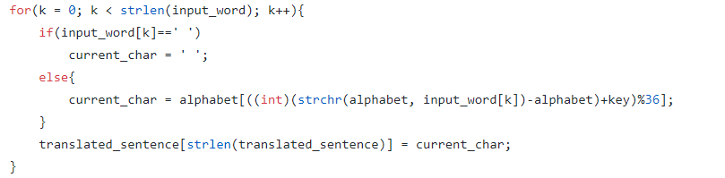
ENCRYPTION
We do this for each character of the input word!

Slide 12
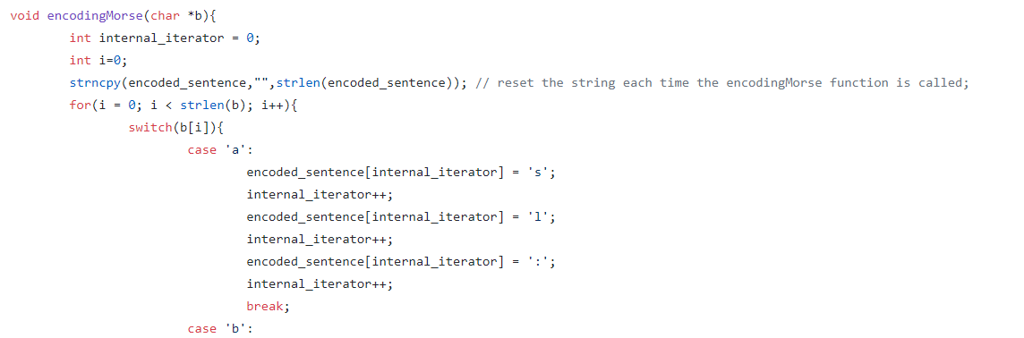
ENCODING
Now we have a ciphred word in a global variable. In order to be able to output it on a LED, we have to encode it again in Morse code.

Slide 13
ENCODING
At the end of the loop, we have our encrypted word in two encodings
In Morse, stored in the global variable encoded_sentence
Ready for LED!
In ASCII, stored in the global variable translated_sentence
Ready for UART!

Slide 14
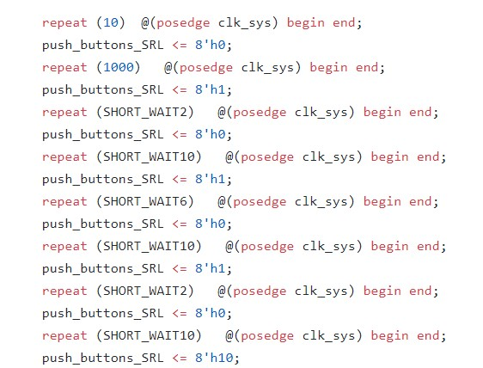
TESTBENCH
Several tests were made to check the hardaware’s behaviour with different inputs.
In the right picture the code of the button pressing simulation is shown. In this case the first button is pushed to generate the signals corresponding to the ‘R’ letter, and the third button to notify that the end of the character has been reached.

Slide 15
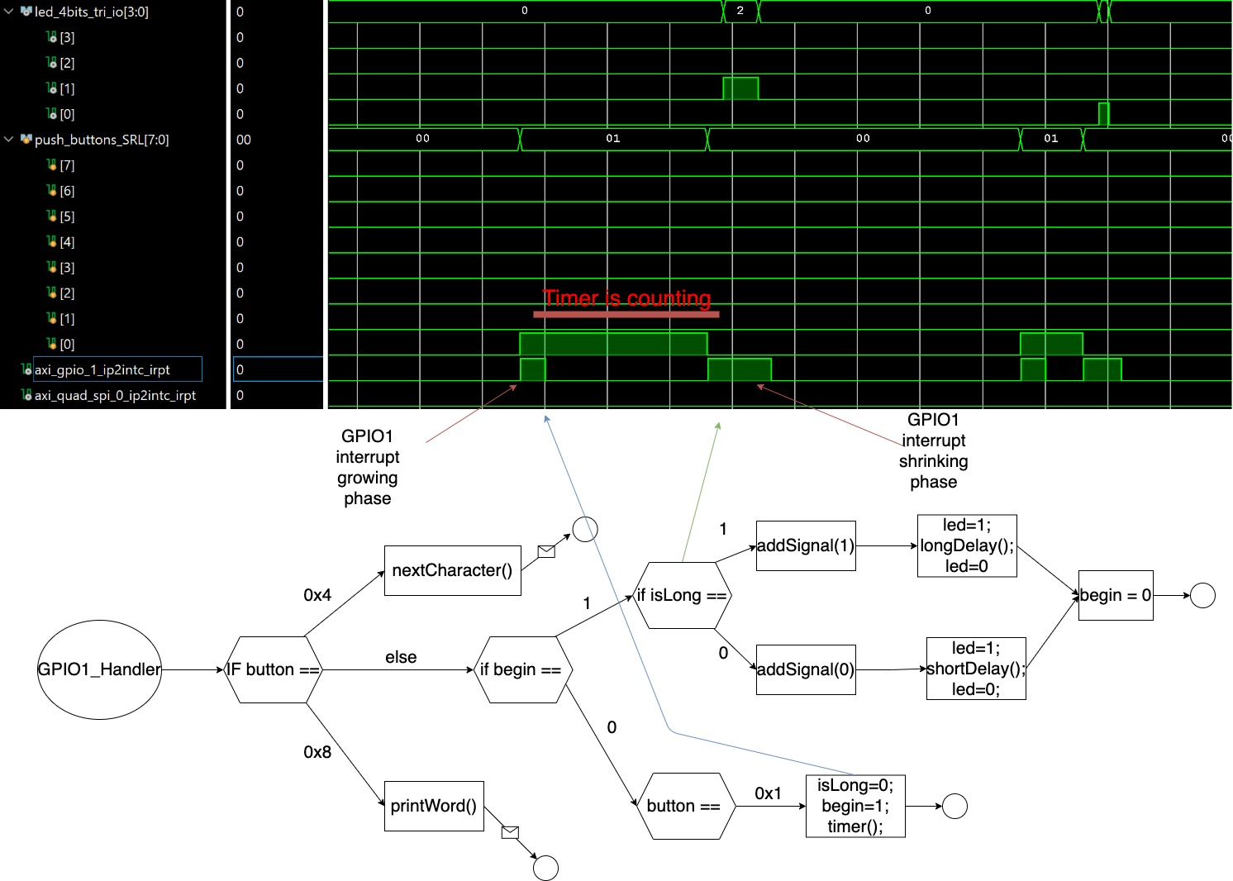
TESTBENCH

Slide 16
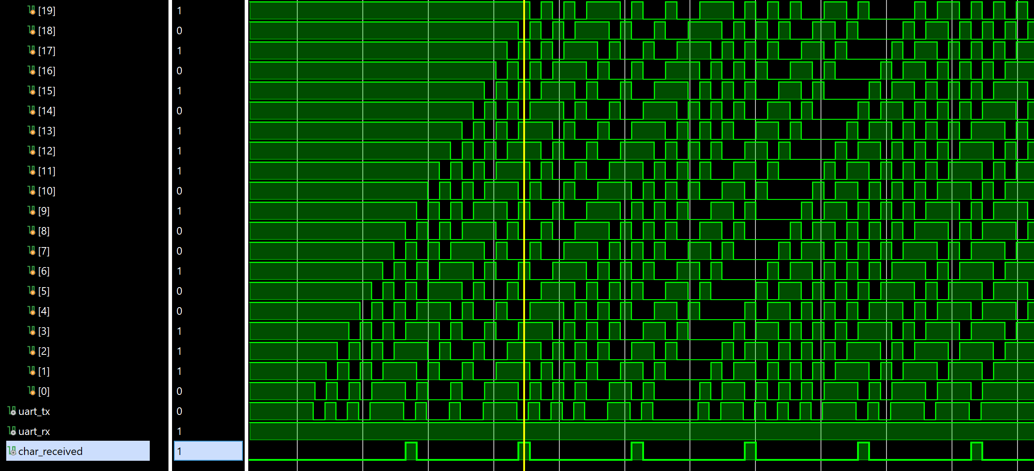
TESTBENCH
UART
The sequence of frames in UART protocol consists of:
Start / Stop bits ➔ 0/1
Data bits ➔ binary format of the character
The binary format of the character ‘U’ is read in the direction of the arrow: strating from the bit before the stop bit to the bit after the start bit
start 1 0 1 0 1 1 1 0 stop

Slide 18

Firma convenzione Politecnico di Milano e Veneranda Fabbrica del Duomo di Milano
Inserimento secondo logo
Fare clic per modificare lo stile del titolo
Fare clic per modificare lo stile del sottotitolo dello schema
Aula Magna – Rettorato
Mercoledì 27 maggio 2015

